Slide 1


Department of CSE
COMPUTER NETWORKS
24CS2202
Topic:
NAT and PAT
Session - 20

Slide 2



AIM OF THE SESSION
To familiarize students with the NAT and PAT protocols.
INSTRUCTIONAL OBJECTIVES
This Session is designed to:
Describe the functionality of NAT protocol.
Describe the functionality of PAT.
LEARNING OUTCOMES
At the end of this session, you should be able to:
Illustrate the importance of NAT protocol.
Demonstrate the functionality of NAT process.
Demonstrate the functionality of PAT process.

Slide 3
NAT

Slide 4
Network Address Translation (NAT)
32-bit IP address become scarce due to its limitation in the number of addresses.
Scenario can be like having IP address assigned dynamically, that is, when required we get an IP address from ISP, and when the session is terminated it can be allocated to some other.
But people working in business applications needs to access internet continuously.
NAT is used to reduce the no. of IP addresses that an organization needs.

Slide 5
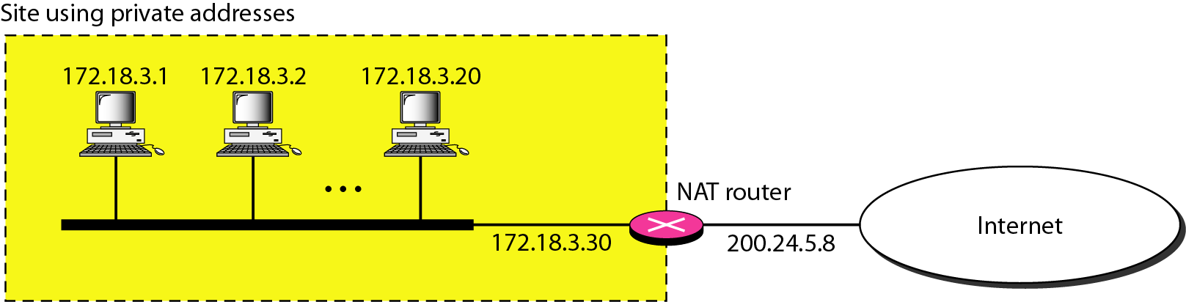
Network Address Translation (NAT)
Assign each company a single IP address(Public) for internet traffic.
Within the company, every computer gets a unique IP address(Private) to manage intramural traffic.
Whenever a packet exits the company and goes to the ISP, an address translation(Private to Public) takes place.
A Network Address Translation (NAT) is the process of mapping an internet protocol (IP) address to another by changing the header of IP packets while in transit via a router. This helps to improve security and decrease the number of IP addresses an organization needs.

Slide 6
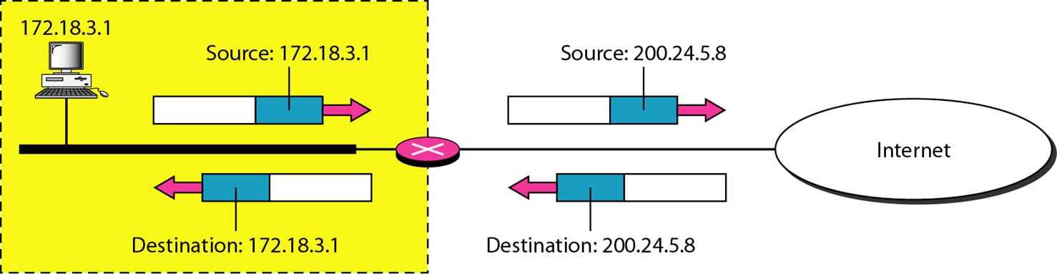
Network Address Translation (NAT)
Addresses in a NAT
Private addresses :
10 . 0 . 0 . 0 - 10 . 255 . 255 . 255 / 8
172 .16 . 0. 0 - 172. 31 . 255 . 255 /12
192 .168 . 0 . 0 - 192 . 168 . 255 . 255 /16

Slide 7
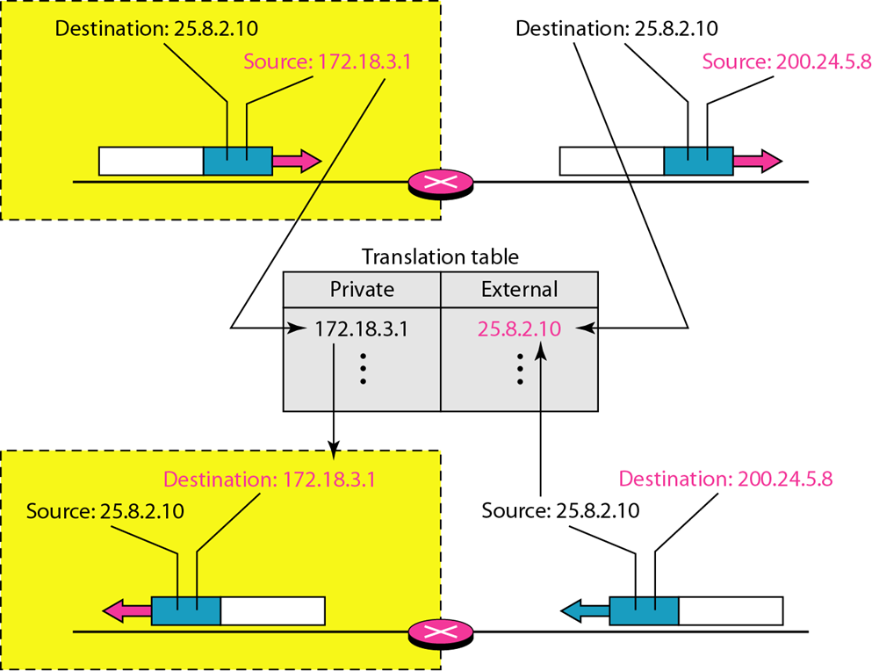
Network Address Translation (NAT)
NAT address translation process:
Source Private IP: 172.18.3.1
Destination IP: 25.8.2.10
Network public IP: 200.24.5.8
These two addresses are recorded in NAT table and the packet is transferred to destination.
Packet while moving to destination, its source private address is changed to public address by NAT.
When an ACK packet is received from destination (Source IP: 25.8.2.10, Destination IP: 200.24.5.8), then NAT will check the table to see if ACK source IP is equal to external address.
If so, then the ACK destination public IP is changed to private IP.

Slide 8
PAT

Slide 9
Port Address Translation (PAT)
Port Address Translation (PAT) is a specific type of Network Address Translation (NAT) technique which is used in computer networking.
PAT is commonly implemented in routers to allow multiple devices within a private network to share a single public IP address due to which it is sometime referred as NAT Overload.
The main task of Port Address Translation (PAT) is to map multiple private IP addresses to a single public IP address by using unique port numbers.
In PAT, Private IP addresses are translated into the public IP address via Port numbers.

Slide 10
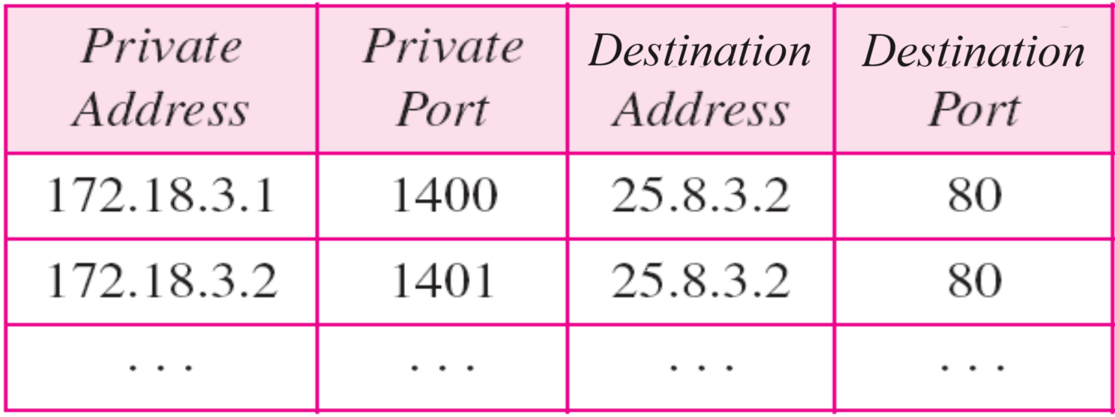

Slide 11

SUMMARY
NAT Protocol
PAT Protocol

Slide 12
TERMINAL QUESTIONS
1. With a neat sketch describe the functionality of NAT.
2. With a neat sketch describe the functionality of PAT.

Slide 13
REFERENCES FOR FURTHER LEARNING OF THE SESSION
Reference Books:
Behrouz A. Forouzan , “Data Communication and Networking”, TMH, 5th Edition, 2012.
A.S. Tanenbaum, David J. Wetheral “Computer Networks” Pearson, 5th Edition.

Slide 14
THANK YOU
Team – Computer Networks

